Slide 1
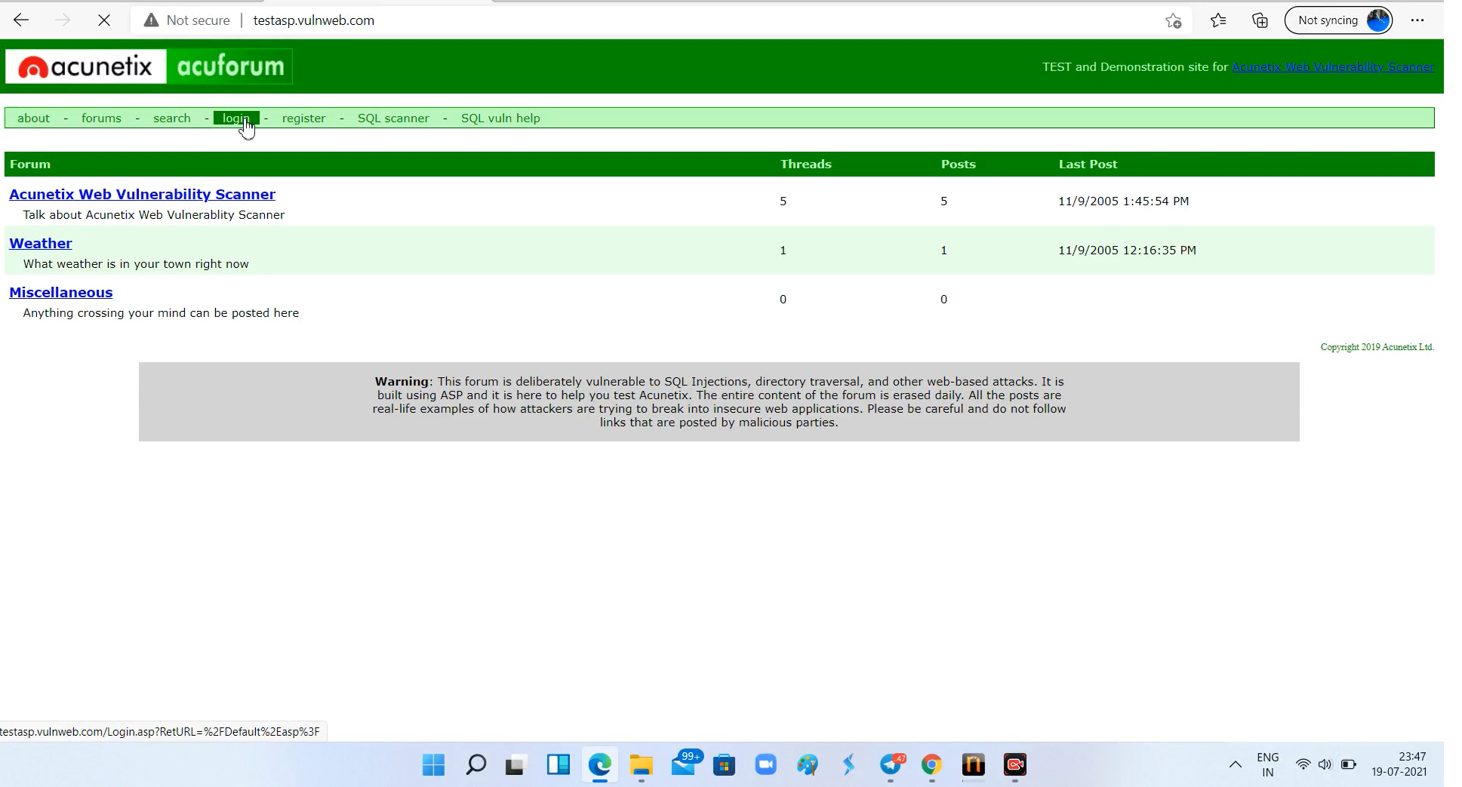
Task 3
Found Vulnerability

Slide 2
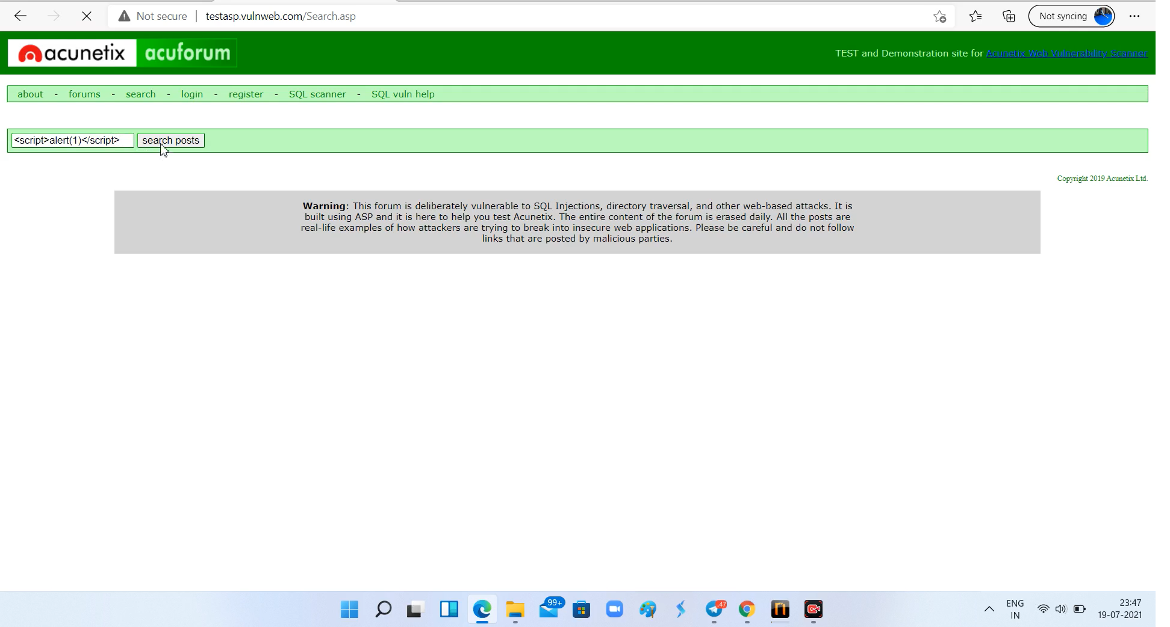
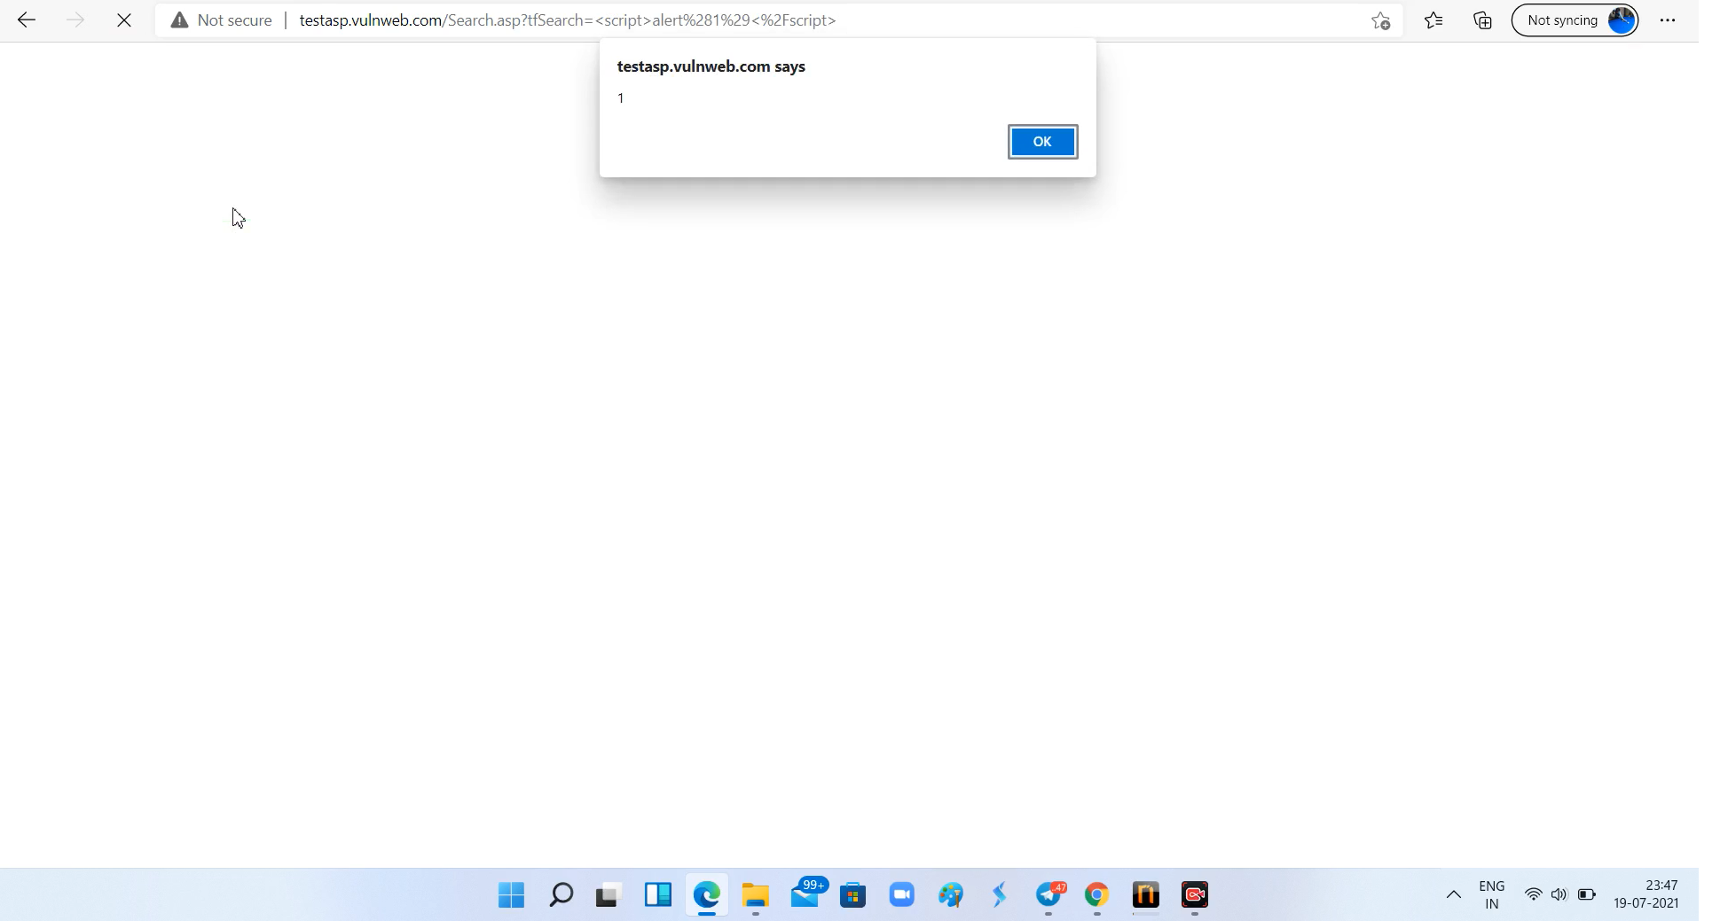
Screenshots

Slide 3
Report
Title: Cross Site Scripting
Domain: Vulnweb.com
Subdomain: testasp.vulnweb.com
Steps to reproduce:
Step1 : Go to testasp.vulnweb.com
Step2: Go to search
Step3: Type payload “<script>alert(1)</script>” and enter search posts
Step4: you will popup with 1 then click on ok and you will able to see the respective results.
Impact: attacker can access the sensective info. on the website.

